Slide 1
Transport Layer Protocols
Dr. Geetha V
Asst Professor,
Dept of IT,
NITK, Surathkal

Slide 2
Index
Introduction
TCP Header Format
3. TCP state diagram

Slide 3
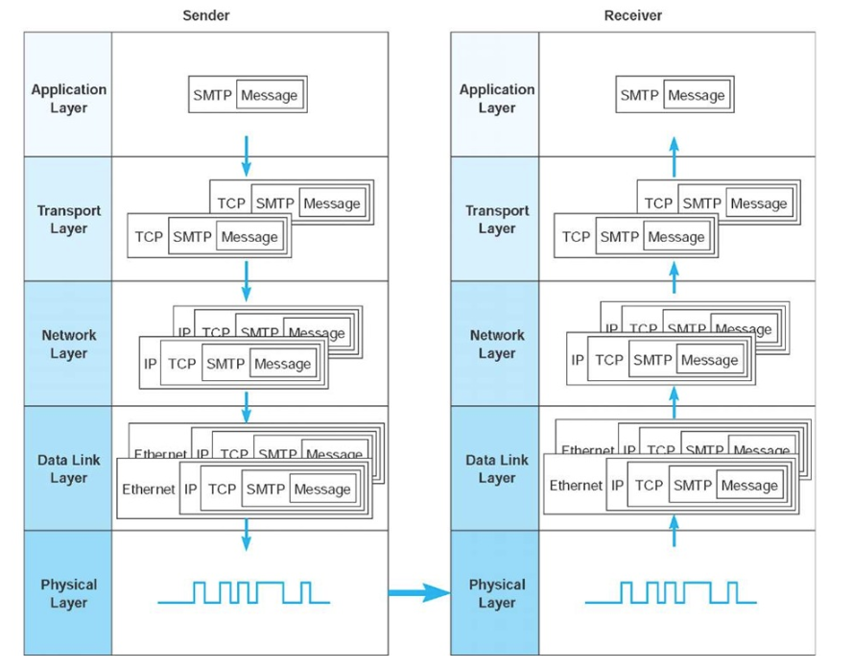
Message Transmission using Layers [1]

Slide 4
Functions of Transport Layer
Guarantees message delivery
Delivers messages in the same order they are sent
Delivers at most one copy of each message
Supports arbitrarily large messages
Supports synchronization between the sender and receiver
Allows the receiver to apply flow control to the sender
Supports multiple application processes on each host

Slide 5
Limitations of Network Layer
Drop messages : Due to link failure or buffer full
Reorder messages: Due to packets may travel in different path
Deliver Duplicate copies: Due to timeout
Limit messages to some finite size: Due to network limitation
Deliver messages after an arbitrarily long delay: due to delay in path or queue

Slide 6
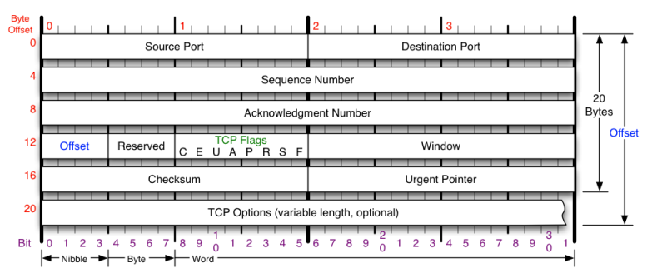
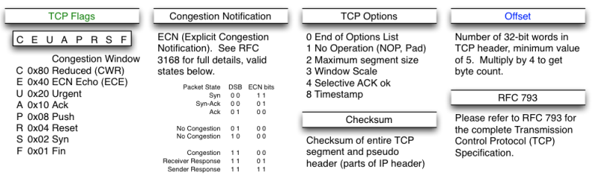
TCP Header Format

Slide 7
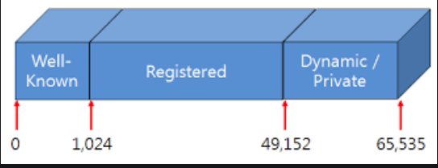
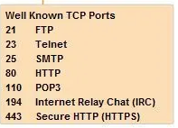

TCP Header
Total data bytes:
65,535-20-20=65,515 bytes (TCP Header 20 and IP header 20)
Source and Destination Port:

Slide 8
TCP Header
Sequence Number (x) and Acknowledgement Number (x+1) :- Indicates the next byte to be received.
32 bit => its numbers are based on number of bytes
Example: explain

Slide 9
TCP Header
Offset/TCP header length (no. of words) : number of 32 bit words in header
5 words => 5 x 4 = 20 bytes (without Options)
Options:
U: URG: Urgent Pointer: U=1 Urgent pointer is valid
A: ACK: A=1 Acknowledgment is Valid
P: PSH: P=1: Push data to application upon arrival
R: RST: R=1 Reset the connection
S: SYN S=1 and A=0: Establish Connection
F: FIN F=1: Release a connection

Slide 10
TCP Header
Window Size:
Sliding window flow control
How many bytes may be sent starting at the byte acknowledged
Synchronization ( 3 way handshake between sender and receiver)
Window size advertisement (example)
Nagle’s Algorithm: Send one byte from sender and buffer other bytes till it receives ACK
Issue - Low bandwidth utilization
Silly Window syndrome : Sending large blocks from sender and receiver, buffer is full and ACK for every byte getting free.
Issue – Every byte extra header overhead (TCP and IP)
Clark’ s Solution: Receiver must wait and advertise only when sufficient buffer space is available
Issue: Sender must wait and it may increase response time.

Slide 11
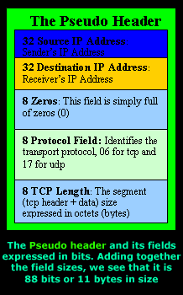
TCP Header
Checksum
To ensure reliability
Checksum is calculated with set of 16 bit words
Initial value for checksum is 0’s
Calculate checksum including Pseudo header +TCP header and Payload
Sender side: Algorithm: add all 16 bit words 1’s complement
Checksum is 1’s complement of the sum
Receiver side: calculate checksum: if the result is zero accept the segment.

Slide 12
TCP Header
Pseudo header
Source address= 198.35.65.5
Destination address: 199.27.46.9
Reserved: 0x00 Protocol: 0x06 (tcp) TCP length: 20 0x14
TCP header
Source Port number = 80 0x50 | Destination Port number=80 0x50
Sequence number = 512 0x200
Acknowledgement = 1024 0x400
Offset=5 Res =0 flags: U A P R S F | Window Size = 1024 0x400
Checksum = 0x00 (Initialization) | Urgent Pointer=0x00

Slide 13
TCP Header
Pseudo header in bits
Source address= 11000110.00100011.01000001.00000101
Destination address: 11000111.00011011.00101110.00001001
Reserved: 0000 0000 Protocol: 0000 0110 TCP length: 0001 0100 pad: 0000 0000
TCP header in bits
Source Port = 0000 0000 0101 0000 | Destination Port = 0000 0000 0101 0000
Sequence number = 0000 0000 0000 0000 0000 0010 0000 0000
Acknowledgement = 0000 0000 0000 0000 0000 0100 0000 0000
Offset=0101 flags: 0000 0001 0000 |  | Window Size =0000 0100 0000 0000
Checksum =0000 0000 0000 0000 |  | Urgent Pointer= 0000 0000 0000 0000

Slide 14
TCP Header Checksum
1100 0110 0010 0011
0100 0001 0000 0101
1100 0111 0001 1011
0010 1110 0000 1001
0000 0000 0000 0110
0001 0100 0000 0000
0000 0000 0101 0000
0000 0000 0101 0000
0000 0000 0000 0000
0000 0010 0000 0000
0000 0000 0000 0000
0000 0100 0000 0000
0101 0000 0001 0000
0000 0100 0000 0000
0000 0000 0000 0000
0000 0000 0000 0000
Sum= 0110 1011 0000 0100
Take 1s complement of sum
0110 1011 0000 0100
That is
1001 0100 1111 1011
So check sum is
1001 0100 1111 1011

Slide 15
TCP Header
Pseudo header in bits
Source address= 11000110.00100011.01000001.00000101
Destination address: 11000111.00011011.00101110.00001001
Reserved: 0000 0000 Protocol: 0000 0110 TCP length: 0010 1000 pad: 0000 0000
TCP header in bits
Source Port = 0000 0000 0101 0000 | Destination Port = 0000 0000 0101 0000
Sequence number = 0000 0000 0000 0000 0000 0010 0000 0000
Acknowledgement = 0000 0000 0000 0000 0000 0100 0000 0000
Offset=0101 flags: 0000 0001 0000 |  | Window Size =0000 0100 0000 0000
Checksum =1001 0100 1111 1011 |  | Urgent Pointer= 0000 0000 0000 0000

Slide 16
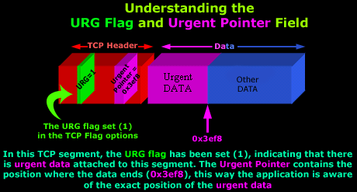
TCP Header
Urgent Pointer:
eg: Upload of large data and TELNET working simultaneously
Portion of data requested by receiver as urgent

Slide 17
Synchronization
Sender
Receiver
SYN_SENT
SYN
SYN_REVD
SYN +ACK
ESTABLISHED
ACK
ESTABLISHED
Data transfer state

Slide 18
Starting Point
CLOSED
1
Timeout
Send: RST
Appl: passive open
Send: Nothing
Appl: active open
Send: SYN
Recv:SYN;
Send: SYN,ACK
5
LISTEN
Appl: send data
Send: SYN
2
Passive Open
Appl: close
Or timeout
3
Recv: RST
SYN_RECD
recv: SYN
Send: SYN,ACK
Simultaneous Open
SYN_SENT
4
Active Open
recv: ACK
Send: <nothing>
6
Recv:SYN,ACK
Send:ACK
7
ESTABLISHED
https://www.tangentsoft.net/wskfaq/articles/debugging-tcp.html

Slide 19
Closing Connection 1

Slide 20
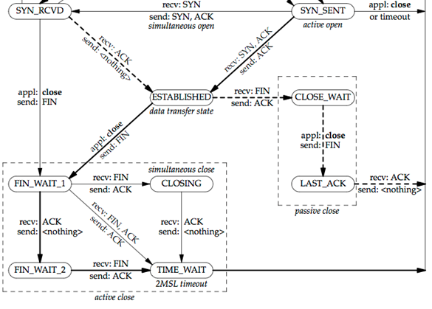
1
3
2
7
4
8
9
5
6
MSL: Maximum Segment Lifetime is the time a TCP segment can exist in the internetwork system. (approx 2 min)

Slide 21
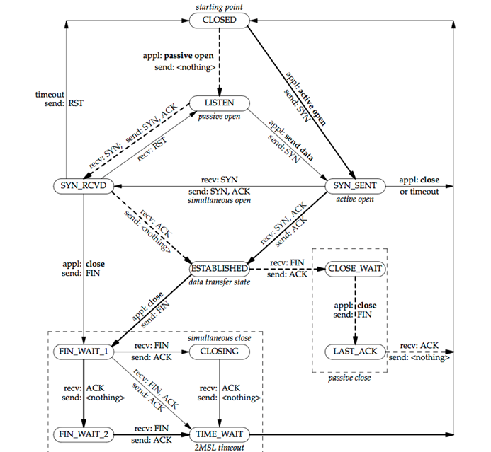

Slide 22
Congestion Control in Transport Layer

Slide 23
UDP (User Datagram Protocol)

Slide 24
Reference
http://what-when-how.com/data-communications-and-networking/network-and-transport-layers-data-communications-and-networking/
Computer Network : Andrew S Tanenbaum

